Slide 1


Green Pace
Security Policy Presentation
Developer: Justin Aebi

Slide 2

OVERVIEW: DEFENSE IN DEPTH
My security policy is to use assertions and exception handling throughout the development of the project until release. This will help find bugs early and help identify where they exist. Assertions can be removed easily before project completion allowing an easier development cycle. This follows defense in depth best practices as it keeps safety a priority and prevents vulnerabilities from slipping through into launch.

Slide 3
THREATS MATRIX
Secure Coding standards have levels that indicate vulnerability and measure impact of the standard.
Likely A threat that is likely to occur | Priority A standard for high relevancy
Low priority A standard with low relevancy | Unlikely A threat that is not likely to occur

Slide 4
10 PRINCIPLES
The ten principles are as follows:
Validate Input Data
Heed Compiler Warnings
Architect and Design for Security Policies
Keep It Simple
Default Deny
Adhere to the Principle of Least Privilege
Sanitize Data Sent to Other Systems
Practice Defense in Depth
Use Effective Quality Assurance Techniques
Adopt a Secure Coding Standard

Slide 5
CODING STANDARDS
Each coding standard is ranked based on their priority level with #1 being the most severe and 10 being the least severe:
Guarantee that storage for strings has sufficient space for character data and the null terminator.
Do not store an already-owned pointer value in an unrelated smart pointer
Detect and handle memory allocation errors
Do not access freed memory
Ensure that operations on signed integers do not result in overflow
Do not rely on the value of a moved-from object
Do not let exceptions escape from destructors or deallocation functions
Range check element access
Handle all exceptions
Use a static assertion to test the value of a constant expression

Slide 6
ENCRYPTION POLICIES
Encryption in rest:
Encryption in rest is secure encoding of data that is stored. If an attacker obtains a hard drive that is encrypted but not the encryption keys, they would not be able to access the data on that hard drive unless they defeat the encryption.
Encryption in flight:
Encryption in flight is the process of encrypting data while it is being transferred or transmitted. If an attacker were to steal data that is being transmitted and that is encrypted, they would not be able to access the data unless they defeat the encryption. Sometimes data is not encrypted while at rest, but instead is encrypted during transmission to provide additional protection.
Encryption in use:
Encryption in use is when data that is being handled is protected in memory or transformed. Password verification uses encryption in use and the use of a hash of the original data is used for comparison.

Slide 7
TRIPLE-A POLICIES
Authentication:
Authentication is the process of proving that you are who you say you are. An example of this is when a user might provide credentials that validate that is the correct user. Such as a username and password.
Authorization:
Authorization means providing correct level of access that a user should have based on their credentials. An example of this is when a user logs into a system, such as a computer, based on the user a set level of access is given, such as a guest logging into something or an admin. Those privileges are then provided based on who or what it is.
Accounting:
Accounting is what is keeping track of what users do while they are logged into a system. An example of this is when a user enters commands into a system or changes data in a database, the system then might log those commands being executed and keep track of them in a file format or the database would keep track of those changes being made. This can be helpful in case of attacks on a system, an admin can look at the log files and identify where something happened, and potentially who issues the commands.

Slide 8
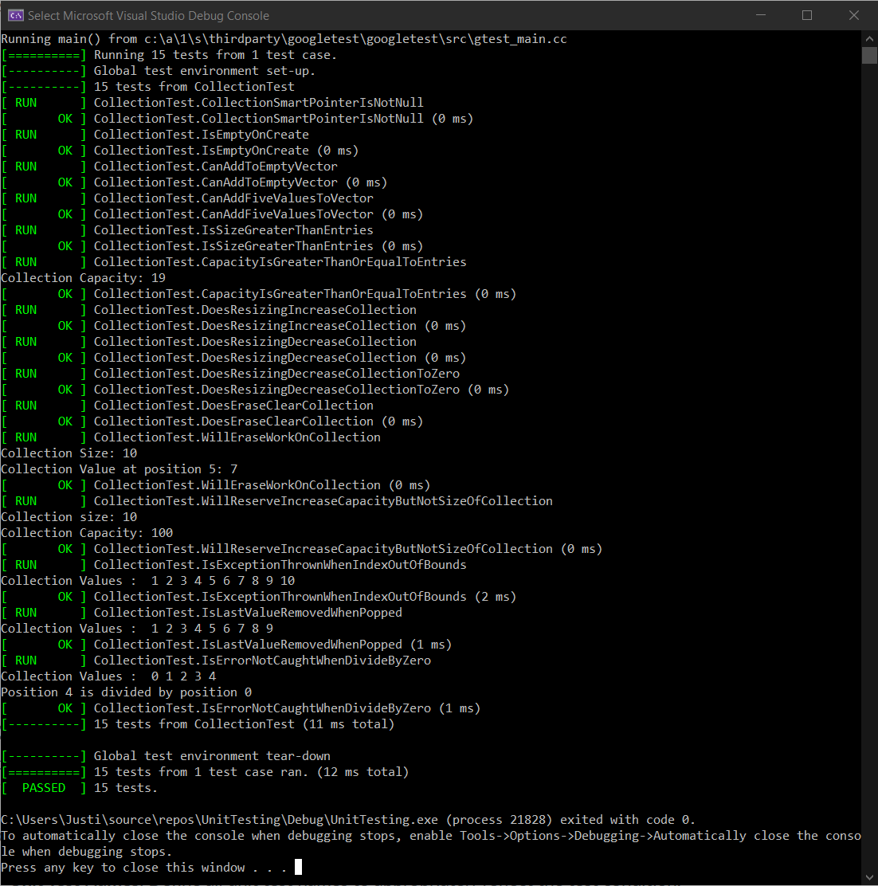
Unit Testing
The next few slides will show some of the unit tests I performed, of which some are positive tests, and some are negative.

Slide 9
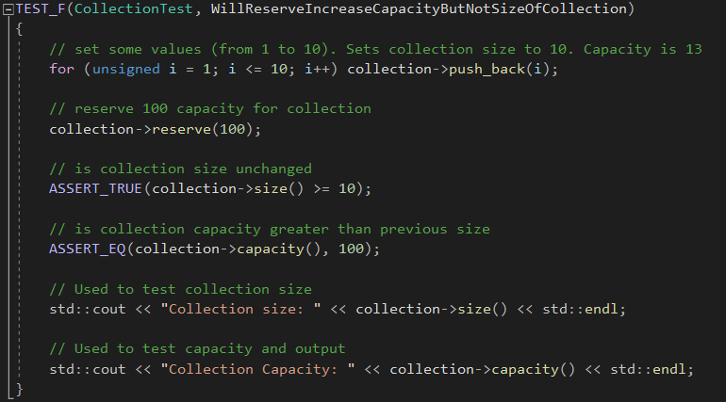
Unit Test One
WillReserveIncreaseCapacityButNotSizeOfCollection:
This tests to verify reserve increases the capacity but not the size of the collection.

Slide 10
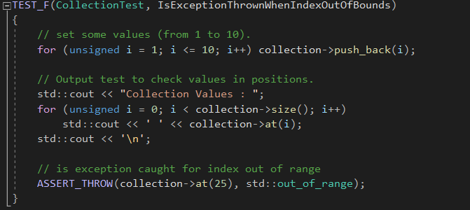
Unit Test Two
IsExceptionThrownWhenIndexOutOfBounds (Negative Test):
This tests to verify the std::out_of_range exception is thrown when calling at() with an index out of bounds.

Slide 11
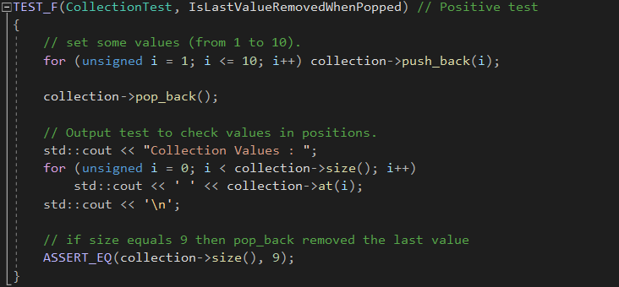
Unit Test Three
IsLastValueRemovedWhenPopped:
This tests to see if the last value is removed properly when pop_back is used.

Slide 12
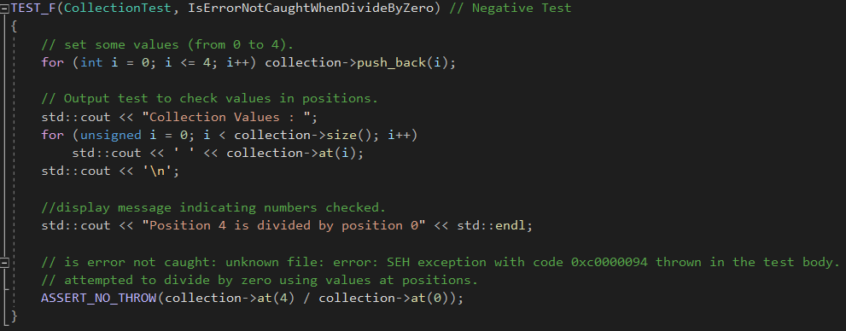
Unit Test Four
IsErrorNotCaughtWhenDivideByZero (Negative Test):
This test is to see if an error is not thrown when an attempt to divide by zero occurs with the values of collection using at() with the position values being 4 and 0, and the value at those positions is the same as the position number. Ex. [0] = 0, [4] = 4.

Slide 13

AUTOMATION SUMMARY

Slide 14
TOOLS
The DevSecOps pipeline is an ongoing process of secure coding implementation into the software development life cycle to minimize vulnerabilities in the code.
The security tools used reside throughout the flow of automation. For instance, the compiler is staged in the build stage of development where most bugs and vulnerabilities can be caught early. This is where the language is translated into something the computer can understand. If it has trouble understanding what is being translated it will alert you with some information to identify the misunderstanding.

Slide 15
RISKS AND BENEFITS
There are many risks that can take place at any point in the development lifecycle and mitigation of these risks must be taken seriously throughout development. Some of the risks involve vulnerabilities or bugs that make it past the build and can cause setbacks in development if only caught later in the lifecycle. Therefore, testing early and often is important. Other problems could be that a vulnerability is not caught at all in the development of a software, and it ends up being released to the public. This can have major ramifications if the vulnerability is discovered and exploited. A huge financial loss could occur if not caught early. To solve these problems, it is beneficial to follow secure coding practices and implement the DevSecOps pipeline and focus on security. The benefits are a safer and functional finalized product that provide little to no risk to the user upon release.

Slide 16
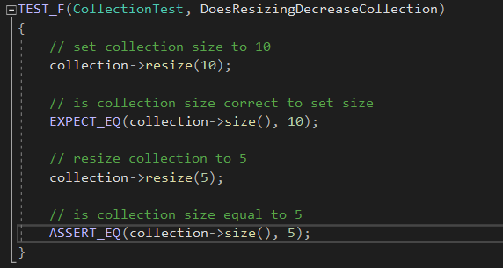
RECOMMENDATIONS
In my analysis of the secure policy I am presenting, there are some gaps that need to be addressed. One of these gaps is that following the policy to ensure assertions are used and exceptions are handled during development only cover some of the vulnerabilities that can occur within development. Something such as an SQL injection might not be caught with basic assertions and exception handling. This is where other policies come into play. This policy is to simply cover the basics of making sure that the code functions as intended on part of the developers coding. This will prevent simple errors in coding from finding their way into the testing stages after the project is built. Attached is an example of how assertions should be used to verify functionality of code.

Slide 17
CONCLUSIONS
In conclusion, the standards listed in this presentation can all be utilized in some capacity, and every standard listed should be adopted to prevent future problems. This may not be possible depending on what type of project is being worked on but with the adoption of these standards comes the prevention of costly mistakes.

Slide 18
REFERENCES
Confluence. SEI CERT C++ Coding Standard - SEI CERT C++ Coding Standard - Confluence. (n.d.). Retrieved February 20, 2022, from https://wiki.sei.cmu.edu/confluence/pages/viewpage.action?pageId=88046682
Confluence. Top 10 Secure Coding Practices - CERT Secure Coding - Confluence. (n.d.). Retrieved February 20, 2022, from https://wiki.sei.cmu.edu/confluence/display/seccode/Top+10+Secure+Coding+Practices

